Slide 1

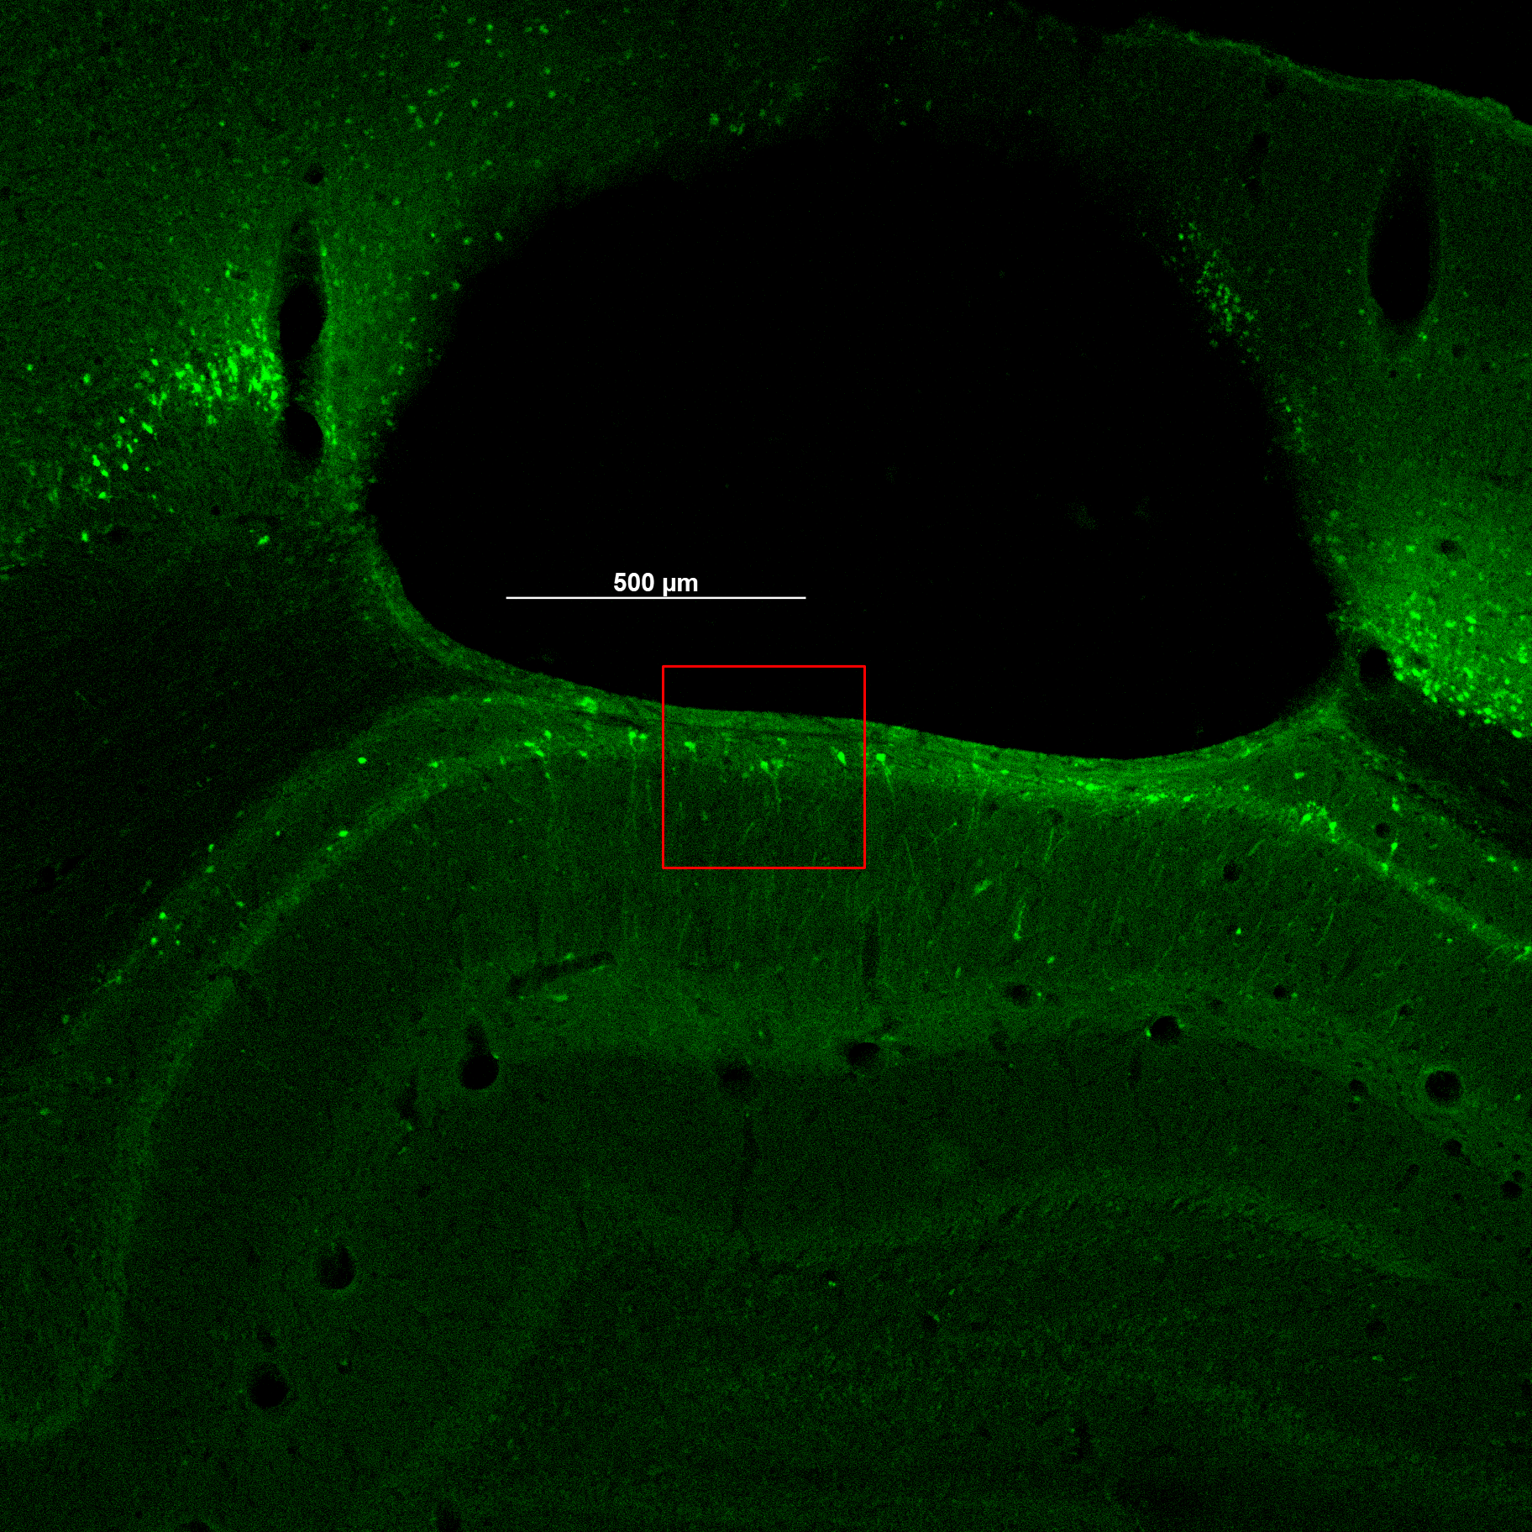
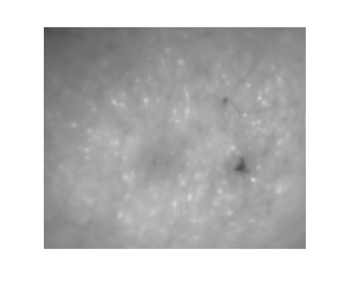
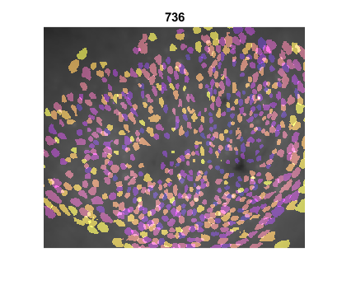
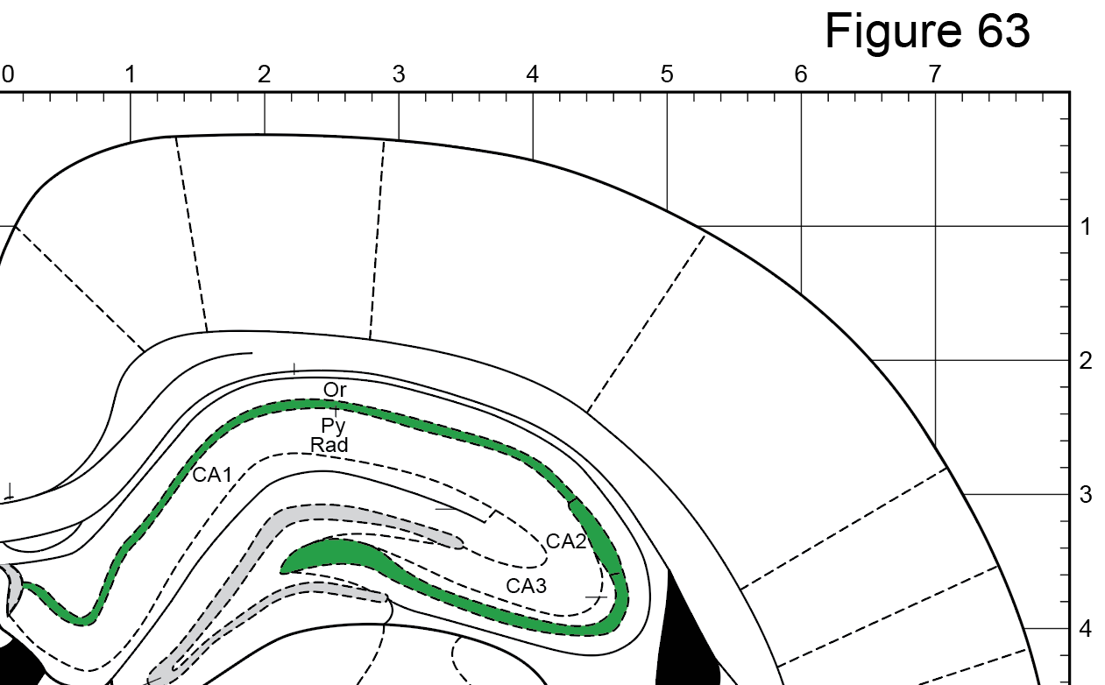
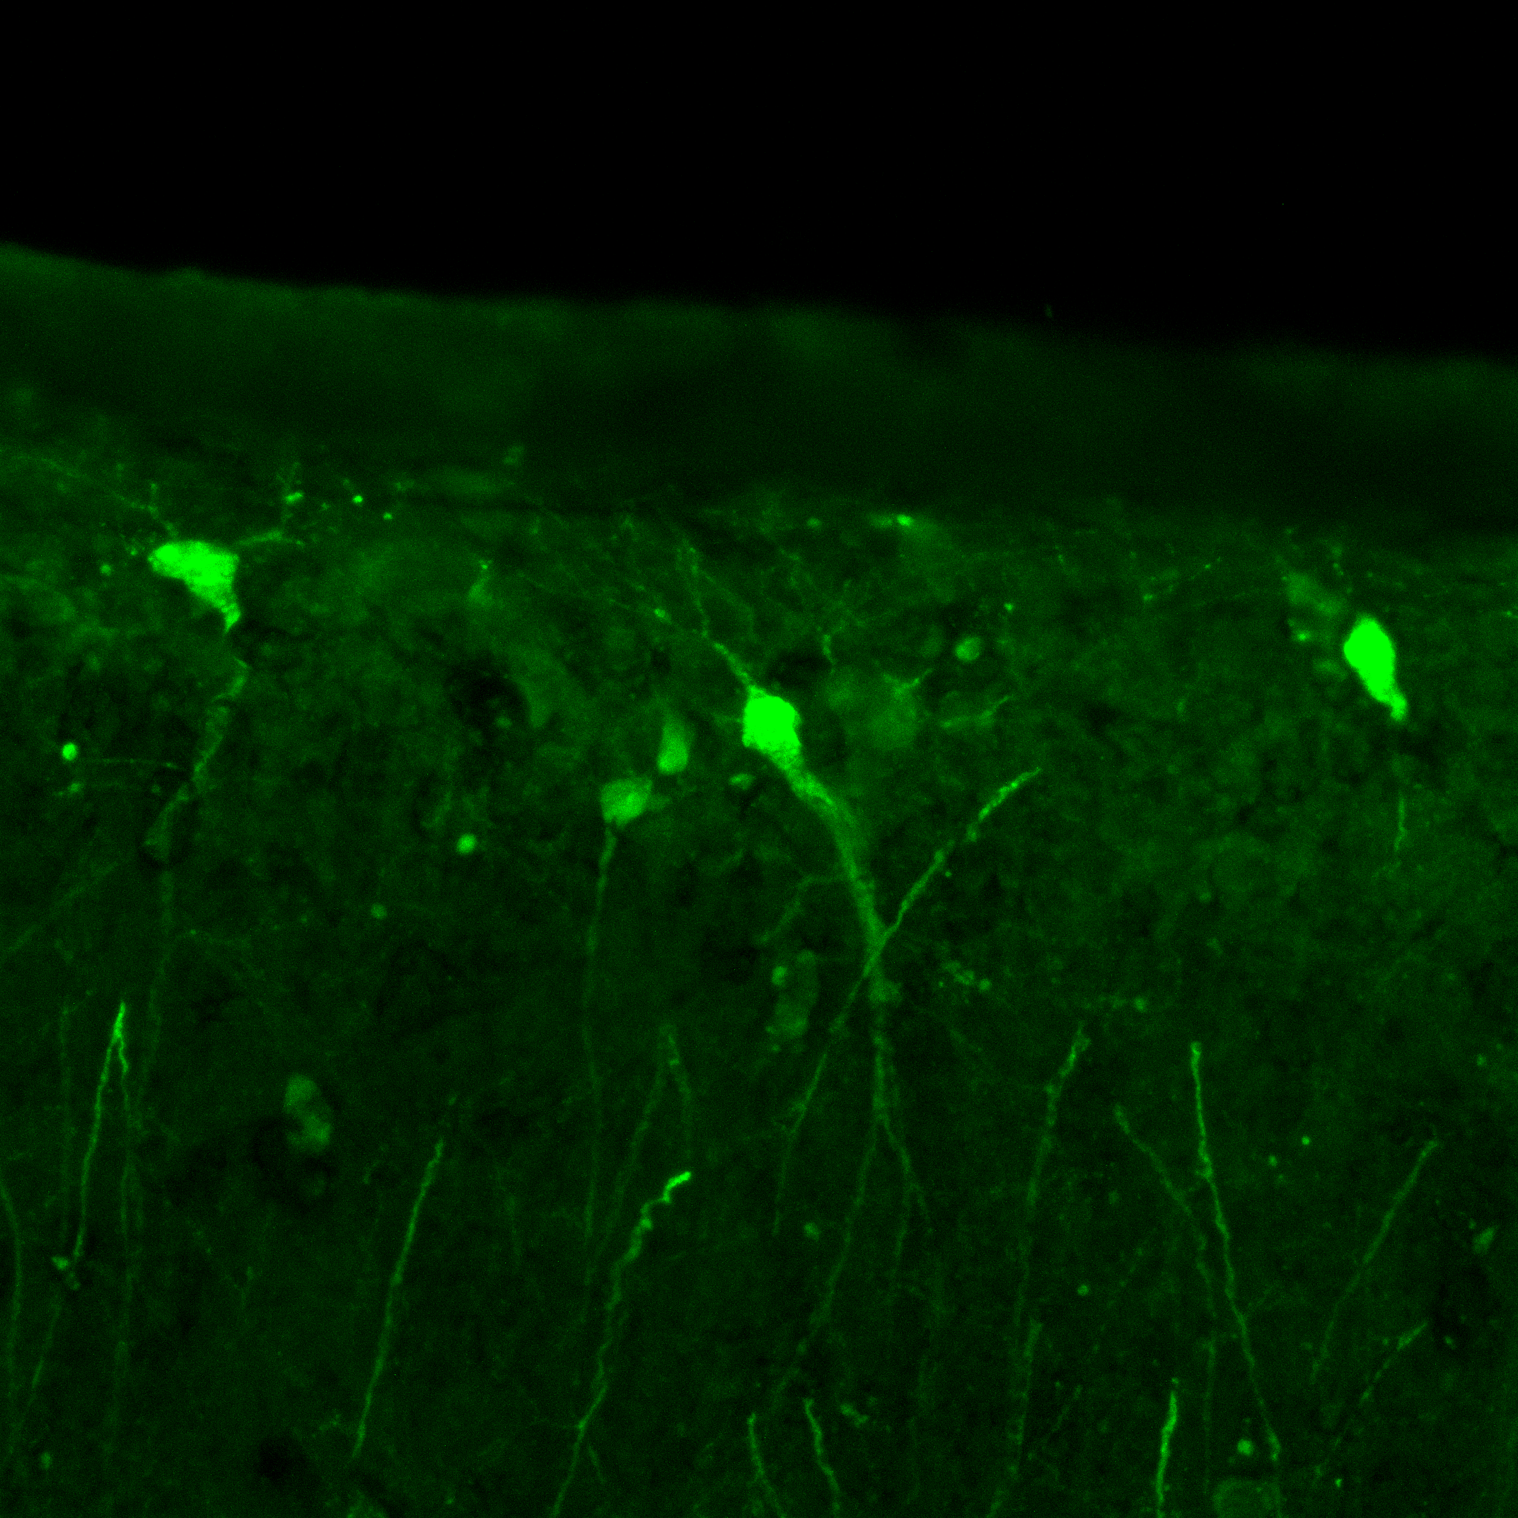
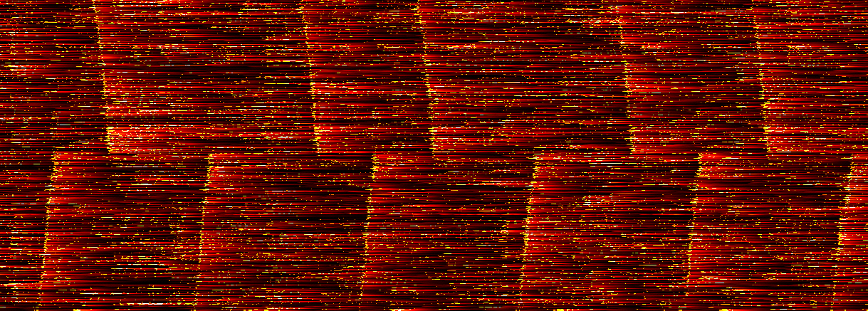
A
LFOV Miniscope
B
C
D
E
n = 736
Baseplate
GRIN lens array
1.8 mm
CA1
Bone cement
Pyr
100 μm
L
V
D
M
500 μm
F
G
SAT
SSI+SAT
BOC
1
1
1
1
1
1
0.8
0.8
0.6
Normalized Ca²⁺ rate
Cell Number
Normalized Fluorescence
0.6
0.4
825
373
Cell Number
602
0.4
0.2
437
0
0.2
150
0
X-position
5 sec
1660
1184
758
-150
0
20
40
Time (s)
60
80
100
Track position
0

Slide 2
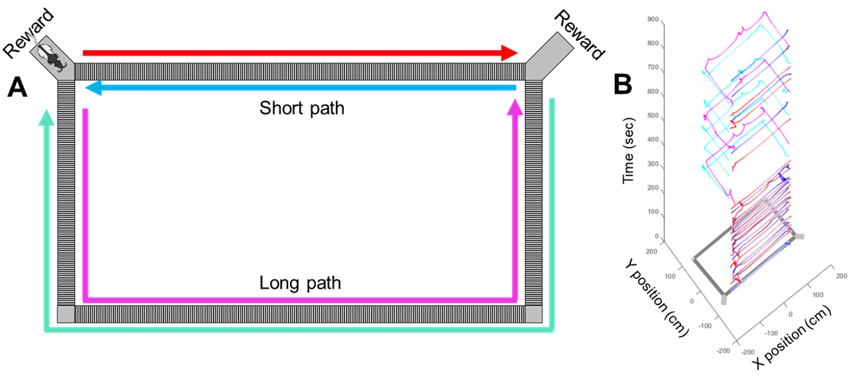
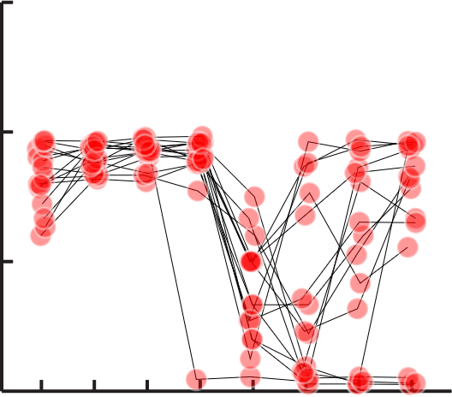
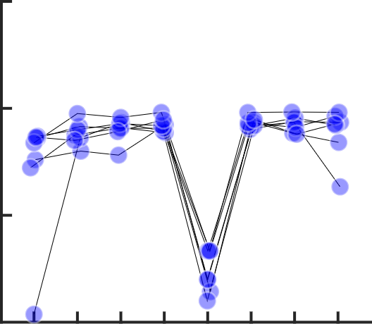
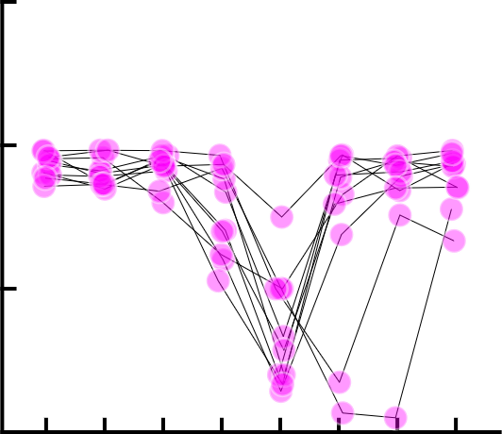
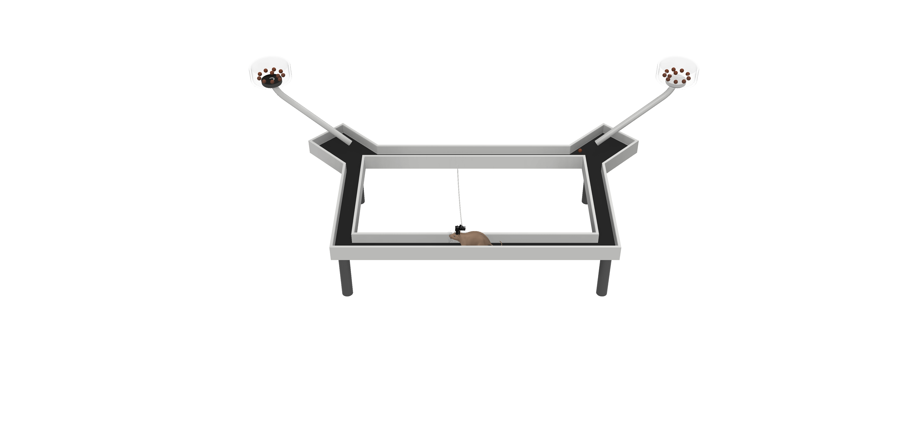
A
B
125cm
250cm
1678 place cells of 4514 total in shock session
C
D
n = 736
E
300
600
900
150
0
5 sec
-150
0
20
40
Time (s)
60
80
100
1200
1
1500
Cell Number
SR →
SL ←
437
F
G
CA1
Ori
Pyr
CA2
Rad
500 μm
DG
100 μm

Slide 3
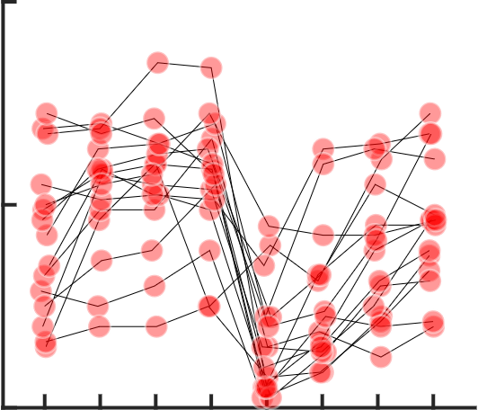
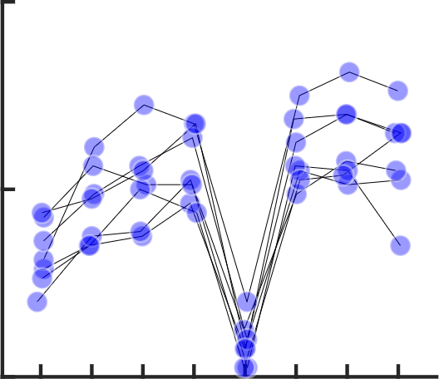
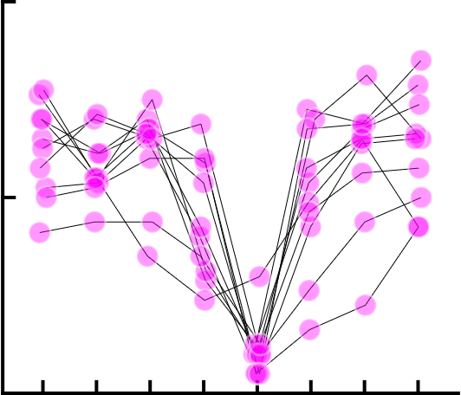
Short path
125cm
Long path
250cm

Slide 4
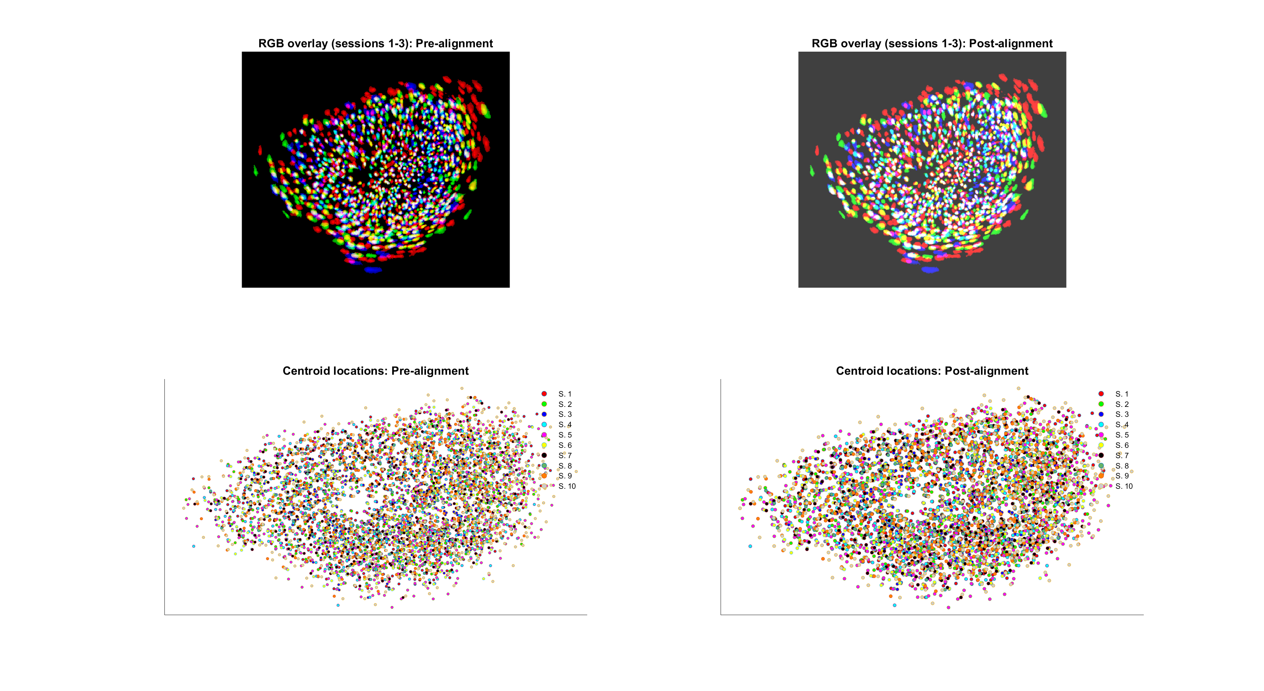
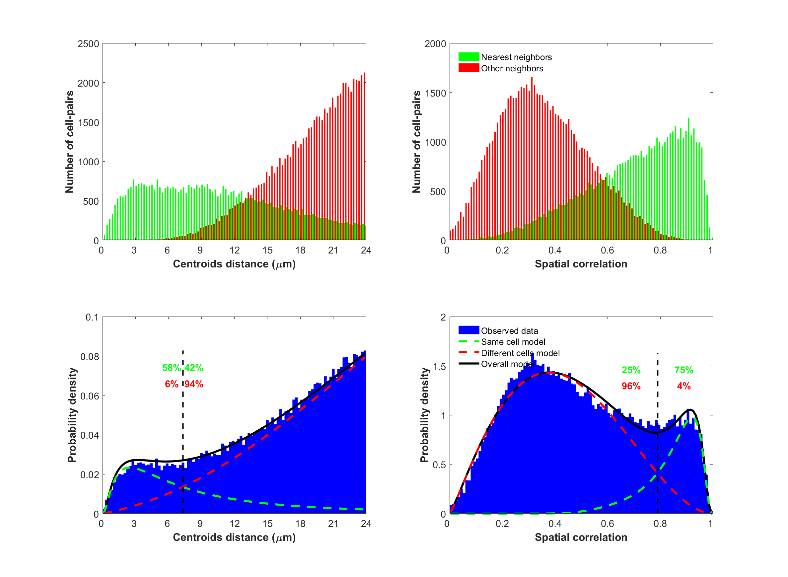
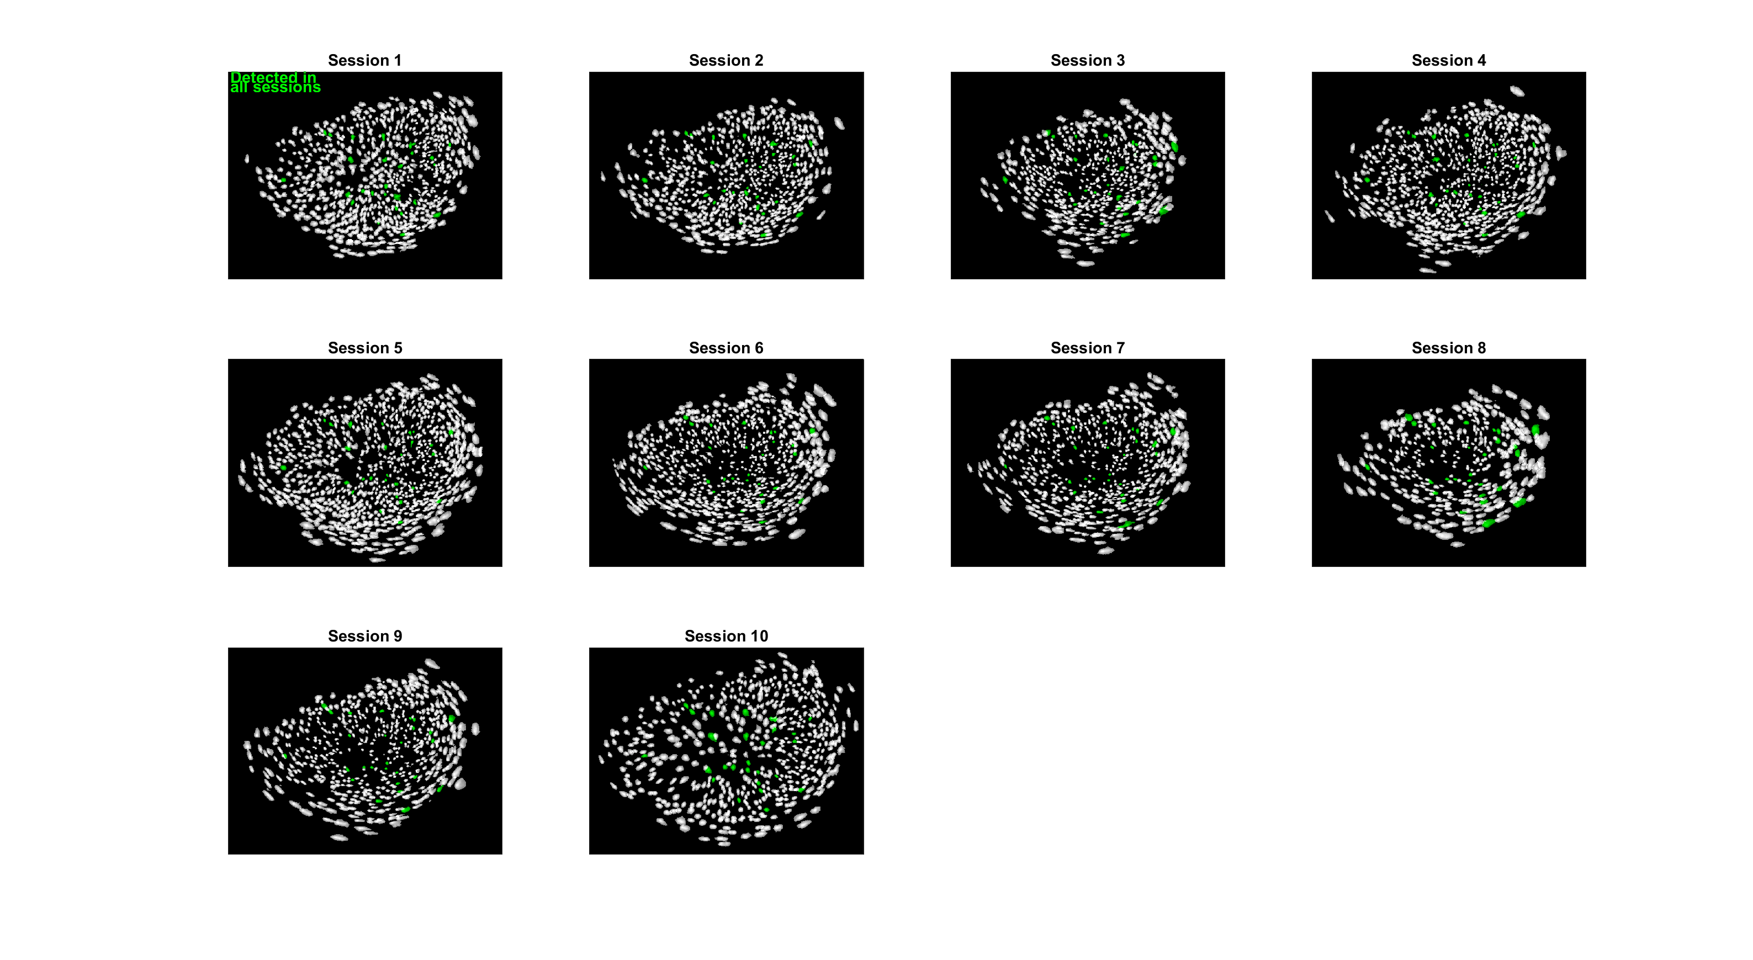
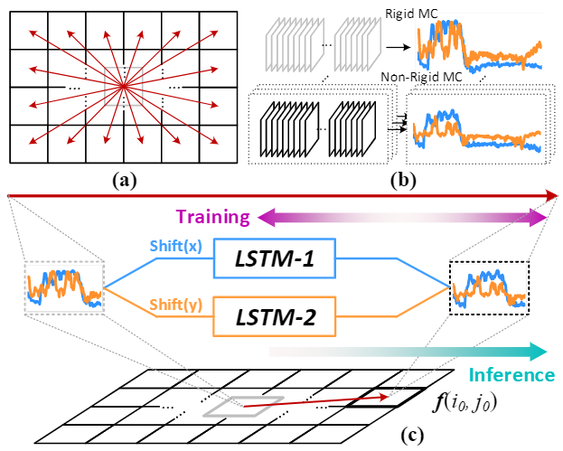
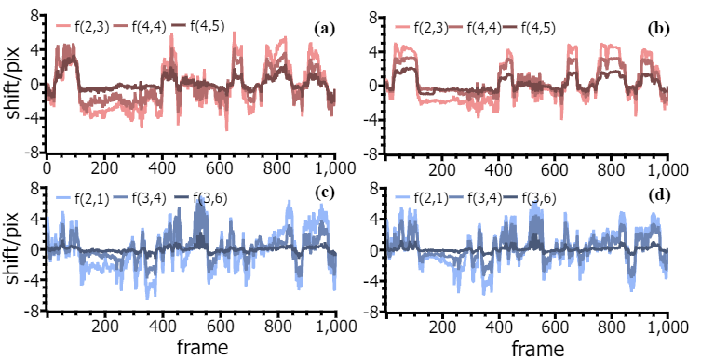
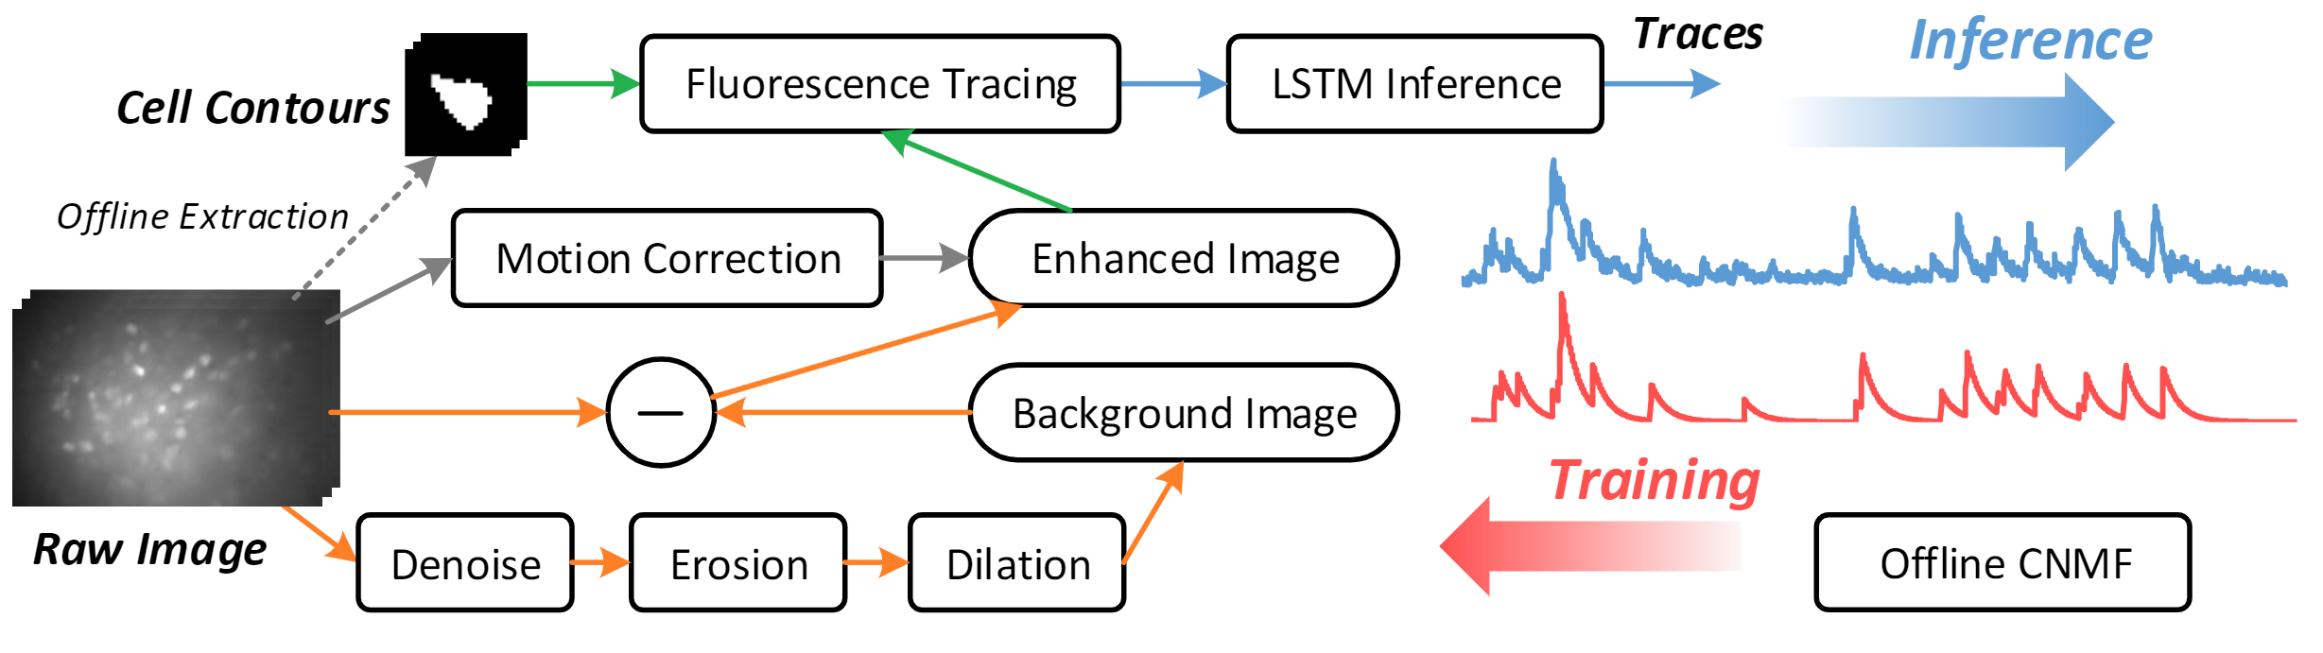
Session alignment
Probabilistic modelling
A
B
C
Cell registration

Slide 5
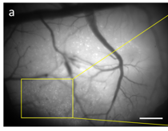
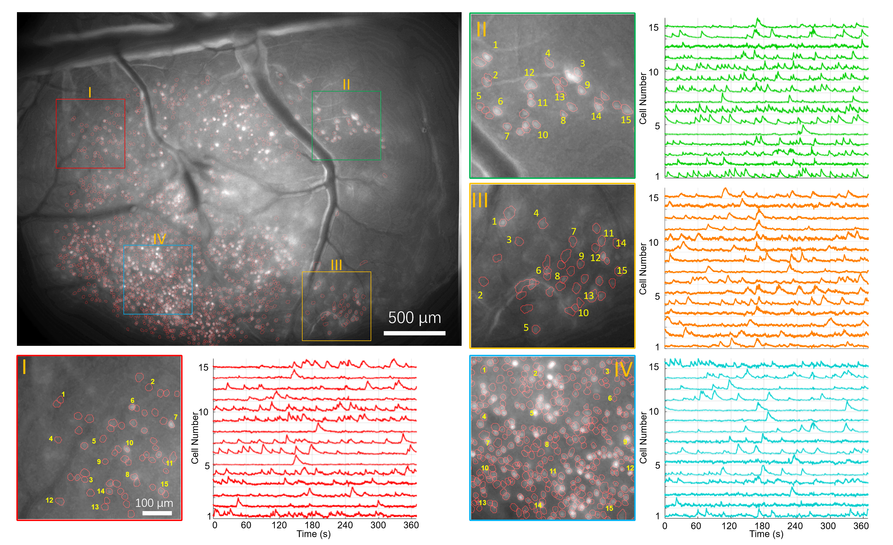
A
B
C
D
E
F

